Slide 1

Connectivity Event
20/10/24
Glasgow City Chambers

Slide 2
Agenda - Morning
Cllr Susan Aitken - City Convener for City and City Region Economy and Just Transition,
Leader of the Council
Kevin Rush - Director of Regional Economic Growth, Glasgow City Region
Glasgow City Region – Smart Connected Social Places Programme (5GIR)
Digital Glasgow
Susanne Millar – Chief Executive – Glasgow City Council

Slide 3
Councillor Susan Aitken
City Convener for City and City Region Economy and Just Transition, Leader of the Council

Slide 4
Kevin Rush
Director of Regional Economic Growth
Glasgow City Region

Slide 5
Smart & Connected Social Places Programme
Glasgow SCSP Connectivity Event 21st October 2024
Barry McNally
SCSP Programme Manager
Glasgow City Region

Slide 6










5G Innovation Region (5GIR) Programme
Smart & Connected Social Places (SCSP) Programme
4 x Sustainability Reports
SCSP Innovation Fund
Smart Social Assets
Connected Care & Wellbeing
Net-Zero Social Assets
Data Aggregation & Business Intelligence
Social Housing
Health & Social Care
Digital & Data
Asset Based Connectivity

Slide 7



DSIT 5G Innovation Region Programme Objectives
Drive economic growth across the UK by supporting places to adopt advanced wireless technologies for services based around local opportunities for growth
Accelerate commercial investment in 5G and other advanced wireless technologies by aggregating and demonstrating demand
Foster the 5G ecosystem enabling “learning by doing”

Slide 8















Smart & Connected Social Places Programme
Smart Social Assets
Deploying 5G and AWT enabled digital & data solutions across social assets to improve the health and performance of the asset and the wellbeing of the citizen.
Connected Care & Wellbeing
Leveraging connectivity, digital, and data solutions to keep people safe, well, and socially connected in their own home or in their local communities

Slide 9
















Smart & Connected Social Places Programme
Net-Zero Social Assets
Harnessing the potential of connectivity, digital and data solutions to support net zero and energy efficiency outcomes in social homes and other social assets
Data Aggregation & Business Intelligence
Assess the potential for aggregating and sharing data and providing actionable insights to transform services and improve lives

Slide 10






Smart & Connected Social Places Programme
Asset Based Connectivity
Mapping 5G and Advanced Wireless Technology Coverage across the Glasgow City Region, and liaising with industry to fill the gaps

Slide 11
SCSP Programme Outputs
4 x Sustainability Reports
Smart Social Assets
Connected Care & Wellbeing
Net-Zero Social Assets
Data Aggregation & Business Intelligence
Sustainability Report Contents
Outline Business Case (5 Case Model)
Strategic
Economic
Financial
Commercial
Management
Use Case 1
Use Case 2
Use Case 3
Use Case 4
Benefits Realisation & Monitoring Plan
Lessons Identified & Evidence Gathered

Slide 12



Smart Social Assets Use Cases
Advanced Connectivity
Solution 1
IoT Sensors collecting data on heat, humidity & CO2
Solution 2
IoT Sensors monitoring the activation of safety devices
Damp & Mould Monitoring & Alert
(Primary Use Case)
Void Identification & Alert
(Primary Use Case)
Fuel Poverty Intervention
(Secondary Use Case)
Fire & Building Safety
(Future Use Case)

Slide 13


Connected Care & Wellbeing Use Cases
Advanced Connectivity &
Resilient Connectivity Solution
Solution 1
Smart Speaker
Solution 2
Smart Plugs
Solution 3
Movement Sensors
Solution 4
Wearables
Voice Activated Call for Assistance / Support
(Primary Use Case)
Streamlined Care Scheduling and Daily Routine Support
(Primary Use Case)
Fostering Social Connectedness & Reducing Social Isolation
(Secondary Use Case)
Remote Health Monitoring & Reporting
(Future Use Case)

Slide 14
Net-Zero Social Assets Use Cases
Advanced Connectivity
Solution 1
Smart Meter/IoT collecting data on Electricity, Heat, Hot Water
Solution 2
Electric Storage Heaters with IoT Sensors
Net-Zero Intervention Monitoring
(Primary Use Case)
Energy Portfolio Level Performance
(Primary Use Case)
Energy Related Tenant Behaviour Change
(Secondary Use Case)
Optimised Electric Heating Systems
(Primary Use Case)

Slide 15




Programme Outputs Vs Benefits Realisation
Shift Focus to Next Stage – Investment & Adoption
Identify Opportunities with LAs & HSCPs
Understand Challenges/Barriers & Devise Appropriate Strategies
Role Model Glasgow City Region as best candidate for further funding

Slide 16
Barry McNally
SCSP Programme Manager barry.mcnally@glasgow.gov.uk

Slide 17

Smart Social Housing
Transforming Services & Improving Lives
Our ambition to provide superfast fibre connectivity into social homes at no cost to the tenants, to keep people safe, well, and socially connected in their own homes and local communities
An Innovative Invest to Save Approach
Renfrewshire Council
Patrick Murray
Head of Digital, Transformation & Customer Service
Innovating | Connecting | Improving Lives

Slide 18
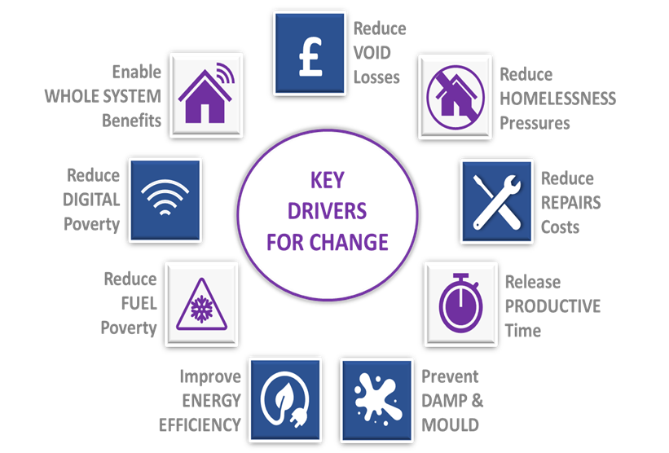
SMART SOCIAL HOUSING: What did we say in January?
PRIMARY HYPOTHESIS TO TEST
“Having secured best value pricing from partners who want to make at-scale social impact, we can build an Invest to Save Business Case to deliver step changes in outcomes by deploying free connectivity to social homes as a platform for deploying in-the-home solutions that enable efficiency, productivity, and performance improvements to be sustained at whole system scale such that the investment pays for itself.”
STRATEGIC DRIVERS
AMBITION
Making the Unaffordable Affordable – provide superfast broadband into 10,000 social homes at no cost to the tenants
Invest to Save – hypotheses-led approach to build a data-driven and evidence-based ‘wash its face’ business case
Foundational Investment – invest in connectivity at-scale as a platform for stacking digital investment cases
Smart Places Platform – provide a connectivity foundation as a springboard for smart investments across the whole system
Whole System Benefits – strategic priorities drive the Go Live bundle and next phase ‘in-the-home’ digital deployments

Slide 19
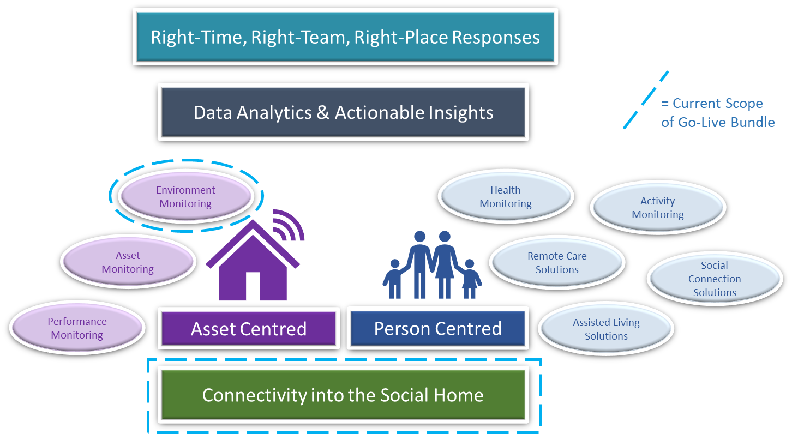
SMART SOCIAL HOUSING: What is it & why do it?
“Digital exclusion can have a severe impact on people’s lives.
For public service reform to be effective it needs to make sure that digitalisation leaves no one behind.”
Audit Scotland, ‘Tackling Digital Exclusion’, August 2024
“Health inequalities and the social determinants of health are not a footnote to the determinants of health. They are the main issue.
Why treat people and send them back to the conditions that made them sick?”
Sir Michael Marmot, ‘The Health Gap’, Professor of Public Health, University College London
“We have not seen significant evidence of the shift in the balance of care from hospitals to the community intended by the creation of IJBs. They cannot address the issues across the sector alone. Whole System collaborative working is needed.”
Audit Scotland, ‘’IJB Finances & Performance’, July 2024

Slide 20
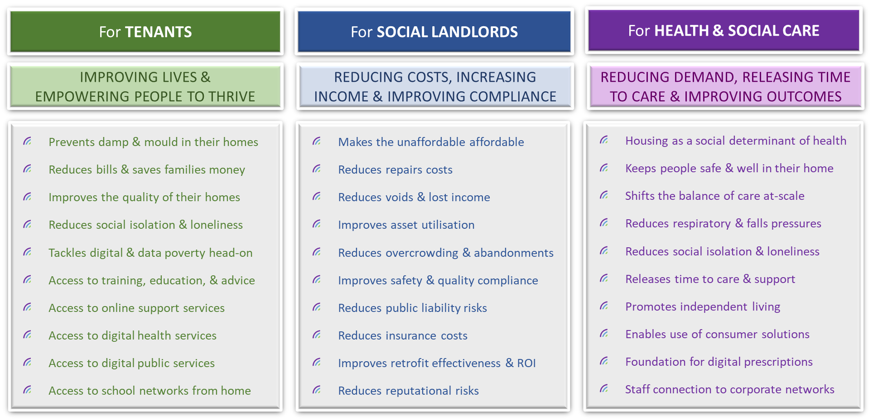
SMART SOCIAL HOUSING: What are the benefits?

Slide 21
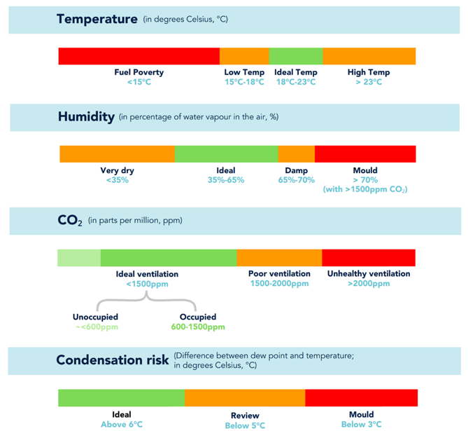
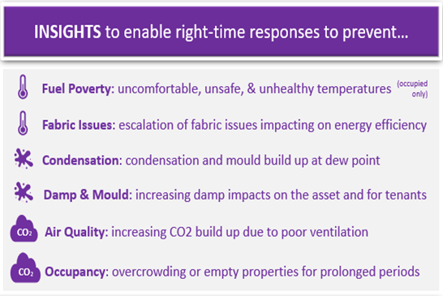
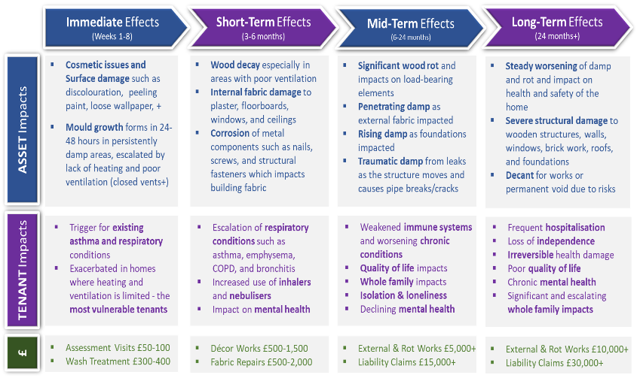
SMART SOCIAL HOUSING: What do the sensors do?
INTELLIGENT ANALYTICS
ACTIONABLE INSIGHTS & PREVENTION

Slide 22
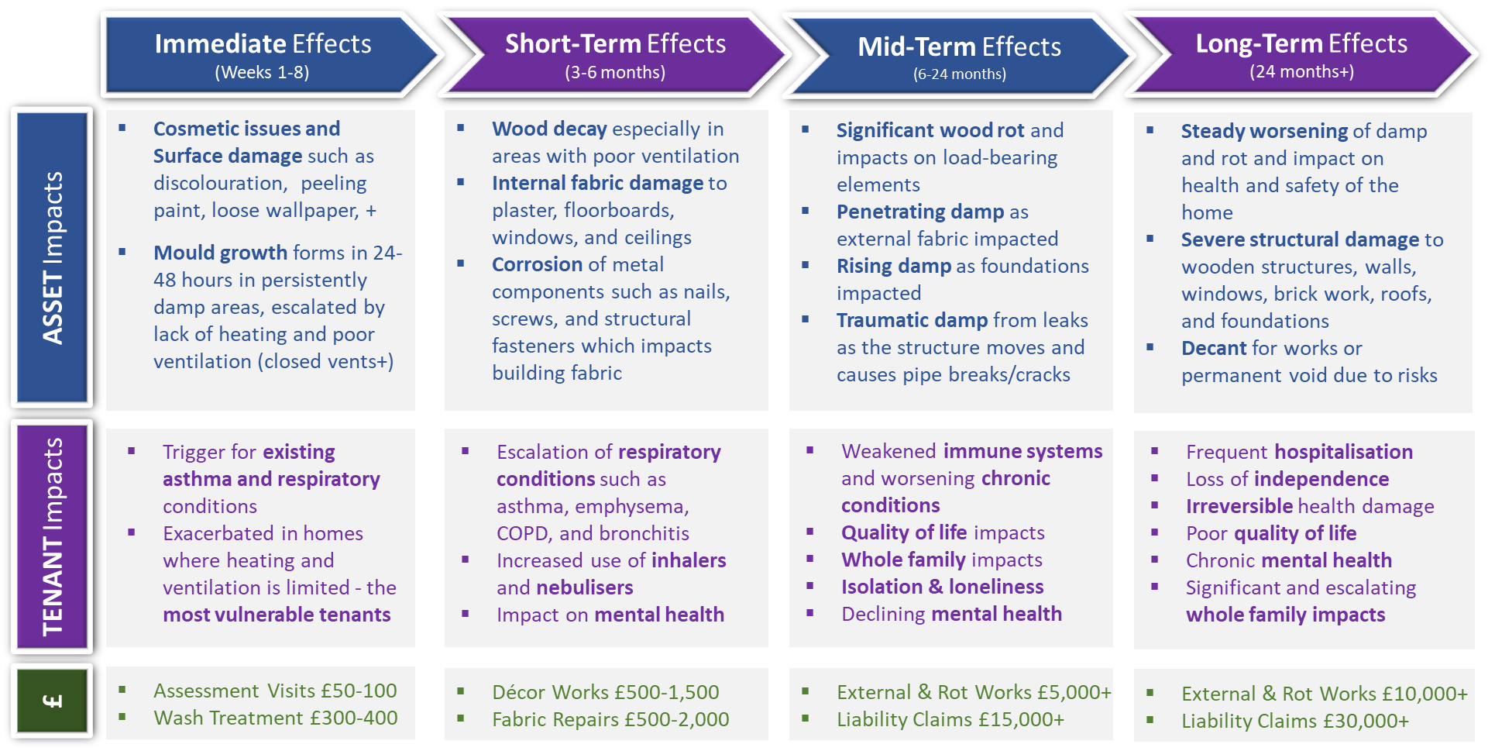
SMART SOCIAL HOUSING: What do the sensors do?
INTELLIGENT ANALYTICS
ACTIONABLE INSIGHTS & PREVENTION

Slide 23
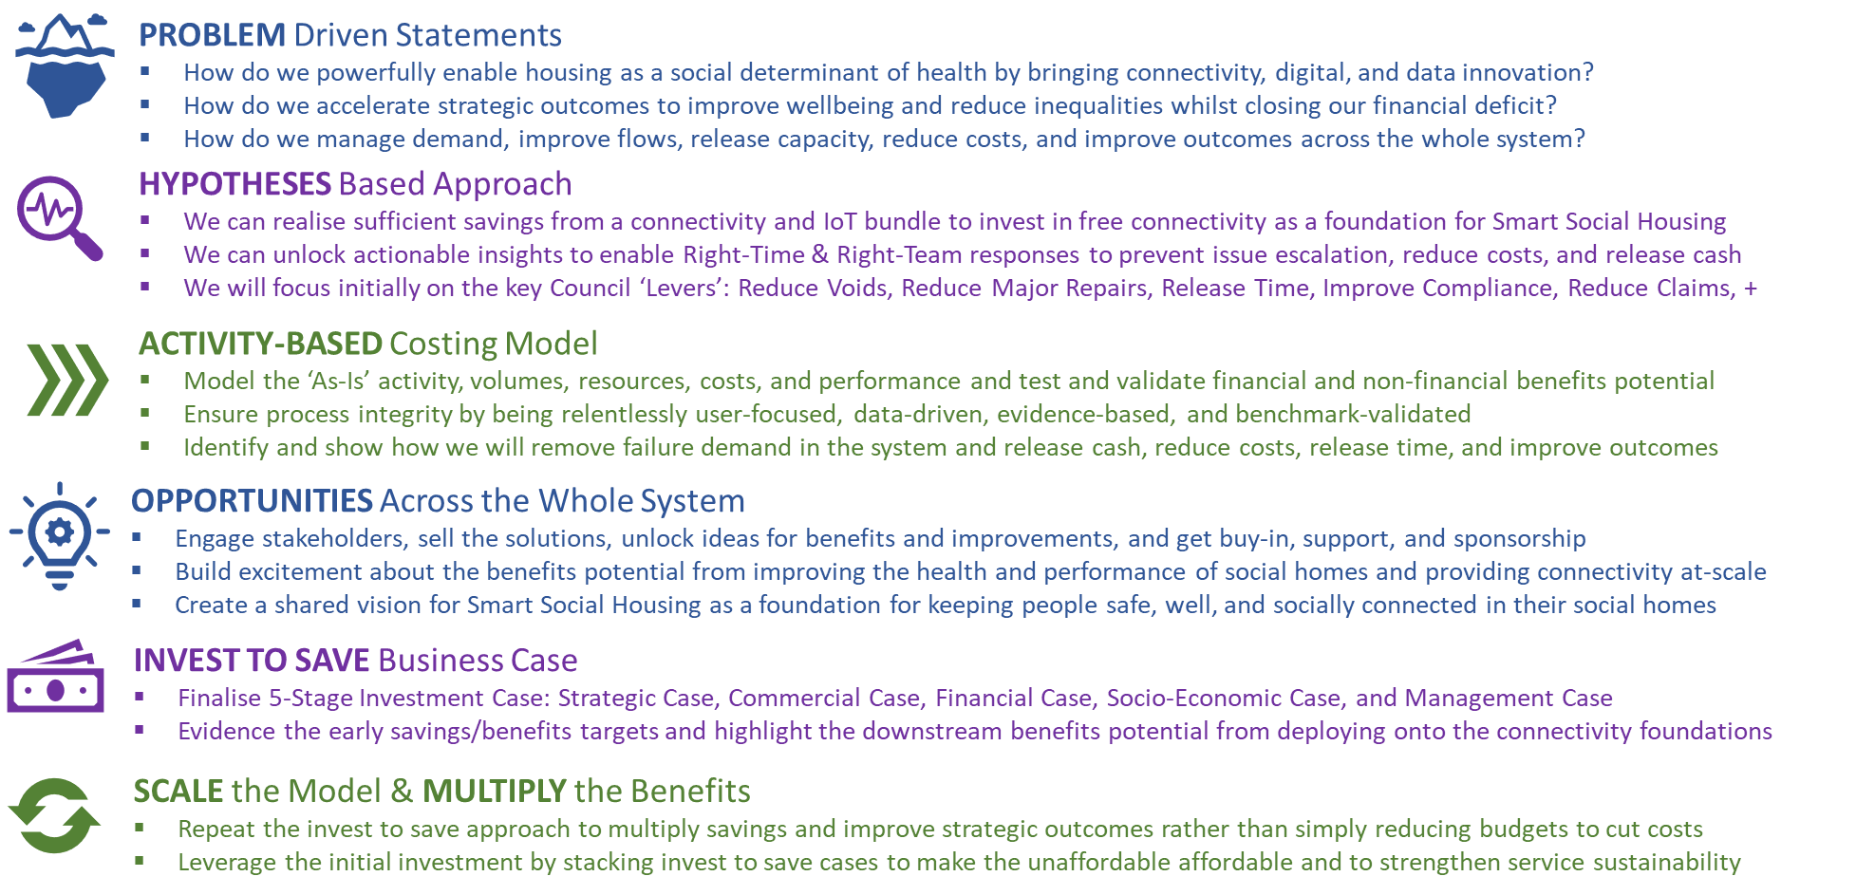
SMART SOCIAL HOUSING: What’s been achieved so far?
PROBLEM STATEMENT
KEY ACTIVITIES COMPLETED
“How do we keep our social tenants safe, well, and socially connected in their homes to improve their health and wellbeing and reduce the poverty and inequalities they experience, whilst promoting prevention and service sustainability given the increasing need to shift the balance of care and improve whole system outcomes?”
40 interviews and workshops to test hypotheses
4 formal Go/No-Go reviews with Renfrewshire CMT
Activity Based Costing (ABC) analysis to size savings
Mapping of sensor data (600 Homes) to repair log data
Savings analysis based on sensors & broadband at-scale
Azure Data Factory and Power BI role-based insights
Whole system engagement on strategic outcomes
SSH catalyst for Smart Care Home (SCH) design
Supporting scaling of GCR-wide business case
V1.0 of SSH Invest to Save Business Case completed
UKTIN Case Study published
SSH Playbook issued (What?, Why? & How?)
DATA DRIVEN & EVIDENCE-BASED
PREVENTATIVE SAVINGS
The environment sensors enable preventative savings:
  50% of homes alerted for damp and mould at least 6 months before reported, 67% 3 months before, and 75% 1 month before
  Spotlight reports in ‘hot’ areas will drive savings and improve best value – ‘virtual tenants’ in Voids, ‘before & after’ Retrofit or Reactive Repairs, ‘archetype analysis’ and asset-based investment VfM & ROI
Click to launch SSH Case Study:
https://uktin.net/how-to-deploy-5G/deployment-toolkits/healthcare/SmartSocialAssets

Slide 24
SMART SOCIAL HOUSING: What are the next steps?
KEY ACTIONS TO CLOSE
Continue the Savings Analysis and validation with Finance and Housing teams based on the current Go-Live solution
Continue the Housing Revenue Account (HRA) and Long-Term Financial Plan alignment analysis
Engage with the HSCP Leadership Team and wider whole system partners on benefits and savings from the current Go-Live scope and future in-the-home solutions that could be deployed at-scale via stacked invest to save cases
Continue dialogue with UK Gov, Scot Gov and other stakeholders interested in scaling the SSH model
Close out dependencies with Housing Management System replacement and Actionable Insights solution design
Continue to build the SSH Partner Ecosystem
Prepare V2.0 of Invest to Save Business Case
Facilitate Final Go/No-Go Decision

Slide 25
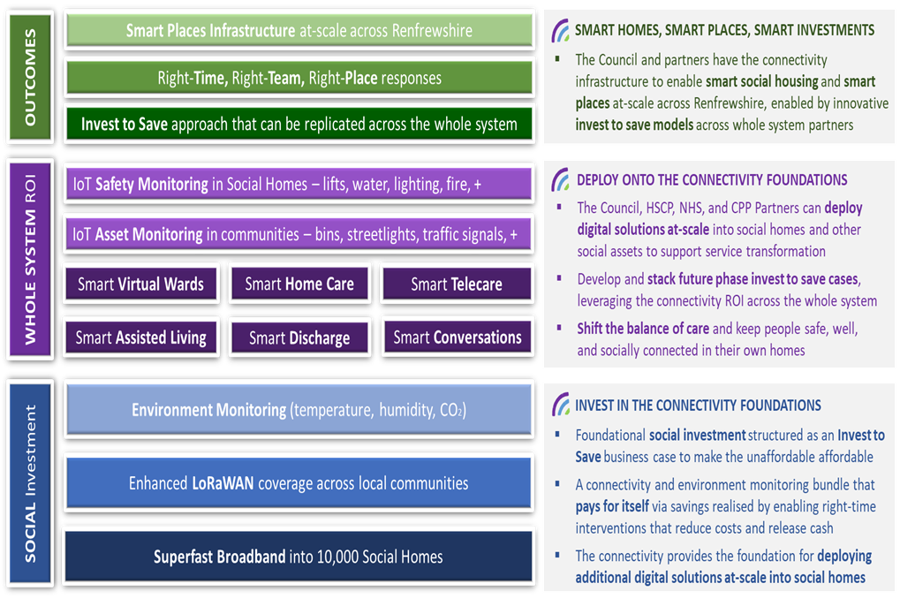
SMART SOCIAL HOUSING: What are the next steps?

Slide 26
Patrick Murray
Head of Digital, Transformation
& Customer Services
Renfrewshire Council patrick.murray@renfrewshire.gov.uk
Iain MacFarlane
Smart Social Housing Project Lead
Commsworld
ssh@commsworld.com

Slide 27


Smart Device enabled Telecare
Testing an innovative alternative model of Telecare for the future, underpinned by consumer grade technology
Utilising Amazon Smart Property Alexa devices to bring smart home technology to telecare service users
Glasgow Health & Social Care Partnership
Glenda Cook
Planning Manager, Older People Planning & Transformation
Stephen Milne
Director of Strategic Projects, Censis

Slide 28
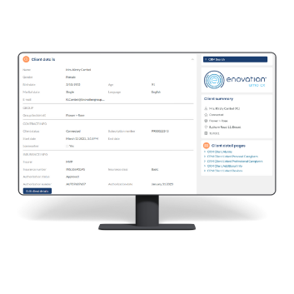
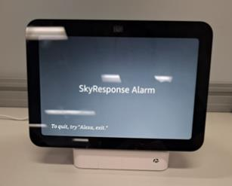


Architecture
Enovation ARC integration
Sensor devices
Alexa and communications hub
Censis Device management platform
Connectivity to cloud and ARC through 4G or 5G connectivity
VOIPconnection into ARC
Property
Connectivity
Cloud

Slide 29

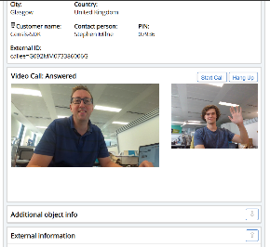


System
Alexa and communications hub
Device management platform
Cloud Alarm receiving platform (ARC)
Sensor devices
Devices connect through Alexa and communications hub
Alexa communicates through Wi-Fi to connectivity hub which uses either 4G or 5G connectivity
Hub connects to AWS servers that host Alexa skill services and CENSIS device management platform. The CENSIS DMP sets up calling between device and ARC
Device management platform hosted in AWS and confirms with OWASP security standard. It allows management of devices and onward connection setup to ARC
Configurations and alert API interaction between ARC platform
Resilience – Battery and Connectivity

Slide 30





Expected Benefits
Increased Functionality
Reduced Cost
Increased Connectivity
Resilience
Reduced Social Isolation
& Loneliness
Increased Confidence
With Technology
Reduced Accidental
Activations

Slide 31
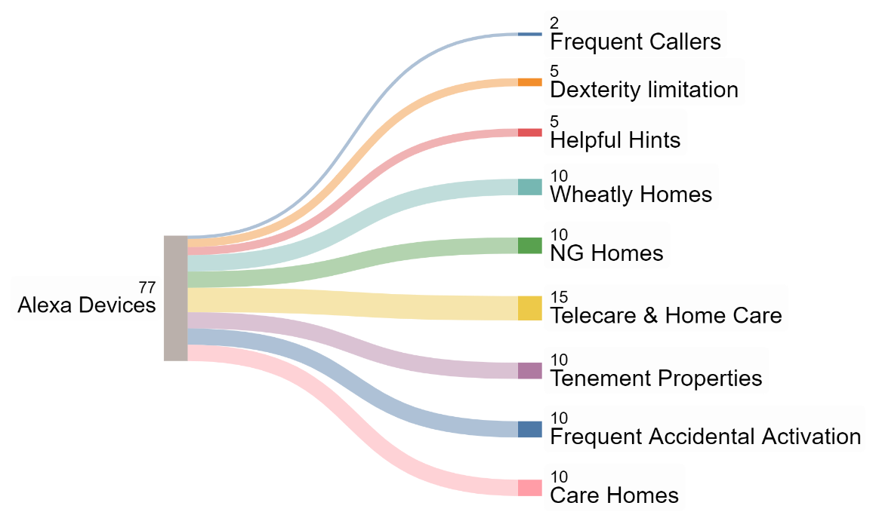
Trial Deployment
3 Month Test Period with the below groups of service users
100 amazon alexa devices, with some service users requiring multiple devices in the home

Slide 32
Trial Deployment
Continue to mitigate challenges
Benefits realisation
Change management

Slide 33
Glenda Cook
Planning Manager, Older People Planning & Transformation
Glasgow HSCP
Glenda.Cook@glasgow.gov.uk
Stephen Milne
Director of Strategic Projects
Censis
Stephen.milne@censis.tech

Slide 34

Measuring Net-Zero Social Assets
Understanding the Challenges of Attaining Net-Zero Social Housing
Trialling the use of IoT Sensors to measure Net-Zero attainment and our progress towards 2045 targets
North Lanarkshire Council
Douglas McCabe
Project Manager, Housing
Tom Davie
Head of Data Insights, iOpt

Slide 35
The Challenge to Reach Net-Zero Social Housing
2045 Objective
0 direct emissions heating systems
EPC rating B
Fabric efficiency rating (TBD)
Energy Efficiency Standards for Social Housing (EESSH) Review
EESSH2 Review Accelerated
Intended Alignment to Net-Zero Targets
Inclusion of new Standards & Metrics
Cost of Regulatory Compliance
£4.6Bn - £9.3Bn
£28K per Flat & £42.5K per House
Estimated Annual Rent Increases of 42% - 80%
*Figures taken from Scottish Housing Regulator Website

Slide 36


Develop a Better System to Measure Net-Zero
Use sensor technology to collect & transmit accurate, real time, data & metrics
Align current practices to emerging best practice
Understand the impact of retrofit activity on the journey to Net-Zero

Slide 37
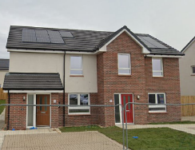

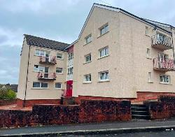
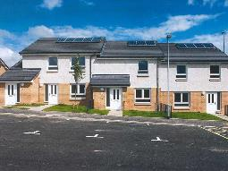
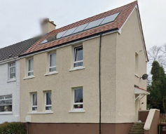
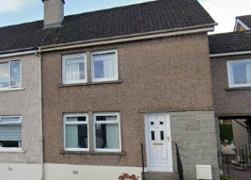
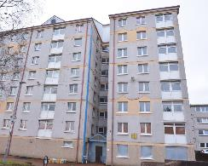
North Lanarkshire Net-Zero Trial
Net Zero Home
Flats (Low Rise)
New Build (Gas)
Retrofitted (EWI)
Non-Retrofitted
Flats (High Rise)

Slide 38







Types of Data Collected
Energy Use Data
Electricity Consumption
Gas Consumption
Renewable Energy Generation
Environmental Data
Temperature
Humidity
CO2 Levels
Key Metrics
Space Heat Demand
Hot Water Demand
Energy Use Intensity
Renewable Energy Contribution

Slide 39
Importance of Data & What We Hope to Achieve
Energy Efficiency Validation
Reducing Carbon Footprint
Supporting Policy and Retrofitting Decisions
Improving Tenant Understanding and Engagement
Tailoring Solutions to Housing Archetypes
Benchmarking
Net-Zero Performance
Data-Driven Optimisation
Long-Term
Carbon Reduction

Slide 40
Douglas McCabe
Net-Zero Project Lead
North Lanarkshire Council
McCabeD@northlan.gov.uk
Tom Davie
Head of Data Insights
iOpt Limited
tom.davie@ioptassets.com

Slide 41
SCSP Innovation Fund
Identifying the Opportunities of Tomorrow
An innovation fund to identify and demonstrate game-changing technologies in Social Housing & Health & Social Care
Glasgow City Region
Sue Waller
Innovation Fund Manager

Slide 42

SCSP Innovation Fund Roadmap
Pre-Launch Planning
Innovation Fund Launch
FAQ updates
Application Deadline
13th August – 16th September
Innovation
Project Awards
Minimum Criteria Check
Stakeholder Moderation
Stakeholder Scoring
17th September - October
Projects
Commence
Feedback to
Unsuccessful projects
Project
121s
Project Completion & Case Study
October 2024 - March 2025
Notes:
Pre-Launch & Stakeholder Engagement 15th-30th August 2024
Innovation Fund Launch 28th August 2024
Deadline for questions 9th September 2024
Applications Close 16th September 2024
Project Awards 30th September 2024
Project Delivery Expected to start October 2024
Feedback to Unsuccessful Projects November 2024
Project Completion & Case Studies March 2025

Slide 43
Successful Applicants by Local Authority
 | South Lanarkshire | 1
 | West Dunbartonshire | 1
 | East Renfrewshire | 1
 | Glasgow | 3
 | North Lanarkshire | 2
 | East Dunbartonshire | Nil App
 | Inverclyde | 1
 | Renfrewshire | 2

Slide 44
Allocation of Successful Projects by Theme
5
4
3
2
1
 |  | Social Housing |  | Health & Social Care |  | Digital & Data

Slide 45






Successful Applicants
&

Slide 46

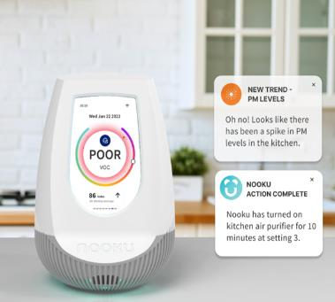
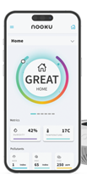

Successful Applicants
STAND 3
Monitoring indoor air quality for
COPD
ASTHMA

Slide 47

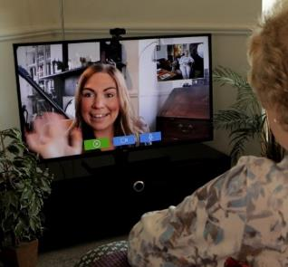
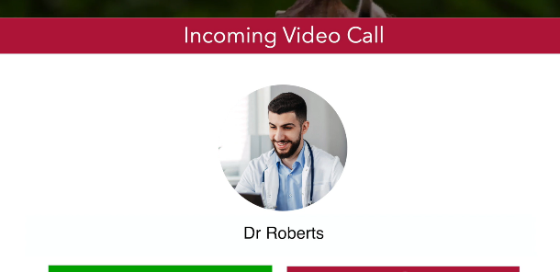
Successful Applicants
STAND 2
Reduce social isolation
Improve wellbeing of residents
Delivering efficiencies to care

Slide 48
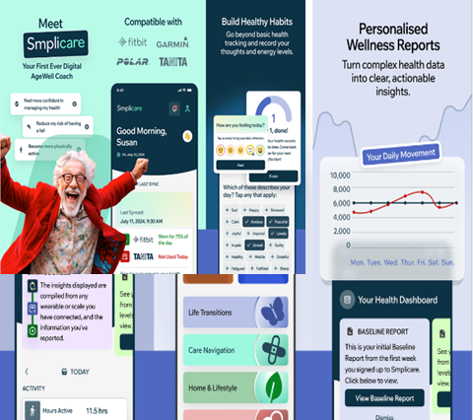
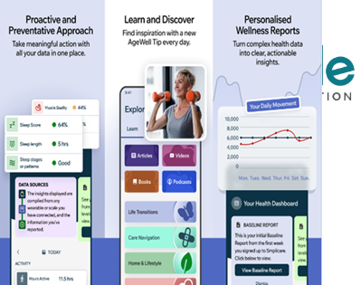
Successful Applicants
STAND 6
Improving health and wellbeing through 5G enabled devices

Slide 49




Successful Applicants
STAND 9
Monitor connectivity & stability
of the 5G connection
Performance and suitability in different care settings (MiFi, WiFi, 4G, 5G

Slide 50




Successful Applicants
STAND 7
Installing sensors to
reduce fuel poverty

Slide 51


Successful Applicants
STAND 11
Digital Solutions
Frailty focus
Monitor new care pathways

Slide 52



Successful Applicants
STAND 8
&
Supporting Housing Association
through a Data Dashboard
Understand Data Points
Monitor environmental Factors
Support Tenants wellbeing

Slide 53
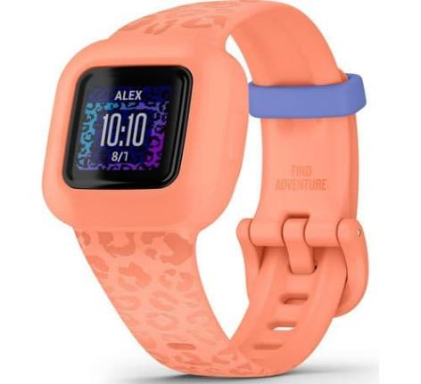
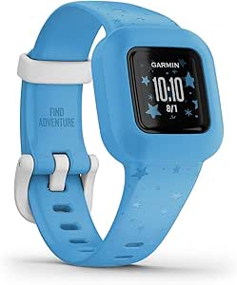
Successful Applicants
STAND 4
Digital Fitness for
Primary School Children &
Adults

Slide 54
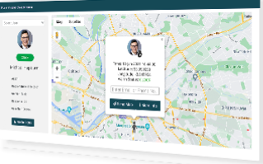
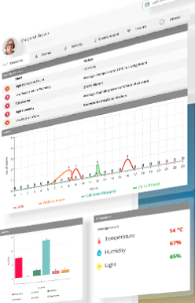

Successful Applicants
STAND 1
Evaluating the delivery of health, social care / housing services within remote and
rural areas.

Slide 55


Successful Applicants
STAND 5
Sensor data & education to understand the benefit of increased ventilation

Slide 56


Successful Applicants
STAND 10
Testing wifi enabled devices in the home to live more independently

Slide 57








































Future Possibilities

Slide 58
Sue Waller
SCSP Innovation Fund Manager sue.waller@glasgow.gov.uk

Slide 59

Welcome to
DIGITAL GLASGOW
Colin Birchenall
Chief Digital Officer, Glasgow City Council
Chief Technology Officer, Digital Office for Scottish Local Government
Notes:
“Digital transformation is not an option.
It is not a back office activity,
It is not optional;
It is essential for Glasgow’s future.
As we navigate the 4th Industrial Revolution, the choices we make today will shape the economic landscape, public services, and community connectivity for future generations. Our commitment to embracing digital innovation will determine whether Glasgow thrives in this new era, ensuring a prosperous and inclusive future for all.”
But our journey doesn’t start today. It started over a decade ago, and we have very strong foundations to build upon…

Slide 60

OUR JOURNEY TO DATE
2014
2015
2016
2017
2018
2019
2020
2021
2022
2023
2024
Innovate UK Future Cities Demonstrator
Digital Glasgow Strategy 2013-2018
EC ERDF Scotland’s Smart Cities Programme
EC H2020 RUGGEDISED Programme
Digital Glasgow Strategy 2018-2023
DSIT 5G Innovation Region
Digital Glasgow Strategy 2024-2030

Slide 61
Achievements to date:
THE ASSETS WE HAVE BUILT
Centre for BI & Data Analytics
(centralised team for driving data-driven transformation)
Innovation Districts
(Place-based approach to facilitating Glasgow’s innovation ecosystems)
City-wide smart infrastructure
(e.g. Intelligent Street Lighting)
Glasgow Tech Ecosystem Platform
(Online platform for matching startups, venture capital)
Connected Learning
(85,000 iPads distributed to school children)
Glasgow Code Learning
(Employability skills for digital roles)
Glasgow Operations Centre
(Integrated operations centre for city services)
Centre for Civic Innovation
(dedicated team to facilitate civic and open innovation)
data.Glasgow.gov.uk
(open data, including a 3D urban model of the city)

Slide 62
WHAT WE HAVE LEARNED
People
Open
Innovation
Data
|
Operational Effectiveness
Improved Outcomes
Economic Opportunity

Slide 63
Introducing the
DIGITAL GLASGOW STRATEGY
2024-2030

Slide 64
PLACING RIGHTS AT THE HEART OF
THE DIGITAL STRATEGY
ACCESSIBLE AND INCLUSIVE
PROTECT AND SECURE
OPEN AND TRANSPARENT
INVOLVE AND EMPOWER
COLLABORATIVE AND IN PARTNERSHIP

Slide 65
A MISSION-BASED STRATEGY
Mission 1
Mission 2
Mission 3
Mission One:
A Fair and Equal Digital Society
Mission Two:
An Inclusive Digital Economy
Mission Three:
Sustainable and Innovative Digital Services

Slide 66
AN OUTCOME FOCUSED STRATEGY
Mission One:
An Inclusive and Empowered Digital Society
Improve Digital Inclusion and Equality
Mission Two:
An Inclusive Digital Economy
Improve the Availability, Capacity, and Quality of Digital Connectivity
Develop the pipeline of digital skills, providing opportunities for all
Mission Three:
Sustainable Digital Public Services
Improve the Efficiency, Resilience, and Agility of our Operations
Build Confidence and Trust in Digital Services
Increase Involvement and Participation
Improve opportunities for Glasgow’s tech ecosystem
Improve the Customer Experience of our Services
Redesign Services to Improve Outcomes for our Citizens and Communities

Slide 67
A FOUNDATIONAL AND ACTION-ORIENTED DIGITAL STRATEGY
Leadership
Workforce & Skills
Collaboration
User-Focus
Data
Innovation
Technology
Security

Slide 68
DIGITAL GLASGOW STRATEGY
The important role of the 5GIR Programme

Slide 69
The important role of the 5GIR Programme
Mission One:
Digital Society
Mission Three:
Digital Public Services
Mission Two:
Digital Economy
Service Redesign
Digital Connectivity
Data-Driven Transformation
Tech Sector
Digital Inclusion
Impact of
5GIR Programme
Innovation / Open Innovation

Slide 70
THANK YOU

Slide 71

Susanne Millar
Chief Executive
Glasgow City Council

Slide 72
Networking Lunch

Slide 73
Agenda - Afternoon
Glasgow City Region Innovation Districts
Ayrshire 5G Innovation Region
Borderlands 5G Innovation Region
SCONDA Programme
Paul Clegg - Portfolio Lead, 5G Innovation Regions - Department for Science, Innovation and Technology - UK Government

Slide 74
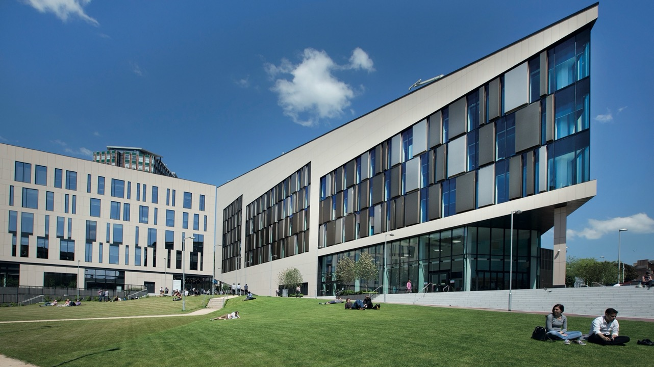

GLASGOW
CITY REGION
INNOVATION
DISTRICTS
Alisdair Gunn – Director GCID
GLASGOW CITY INNOVATION DISTRICT

Slide 75

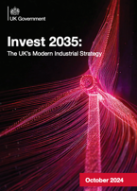



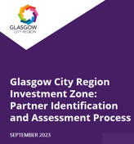


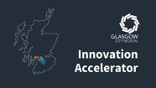


Knowledge Driving Innovation
National Policy (UK)
National Policy (Scotland)
Regional & City Policy (Glasgow City)
UK Industrial Strategy
Scotland’s National Strategy for Economic Transformation – NSET
Scotland’s Innovation Strategy
Glasgow City Region Economic Strategy
Glasgow City Region Investment Zone
UK Innovation Accelerator
Scotland’s Tech Sector Strategy - STER
Pathways: A New Approach for Women in Entrepreneurship
Glasgow City Centre Strategy
Glasgow City Region Innovation Action Plan

Slide 76







GLASGOW CITY INNOVATION DISTRICT
Scotland’s global hub for entrepreneurship, innovation, collaboration and deep tech. Anchored by the University of Strathclyde and centred on Glasgow’s thriving Merchant City.
The District is home to innovative companies and organisations, who locate here to nurture and accelerate inclusive growth, improve productivity and develop world-class talent, research and technology within a vibrant ‘live, work, play and innovate’ environment.

Slide 77

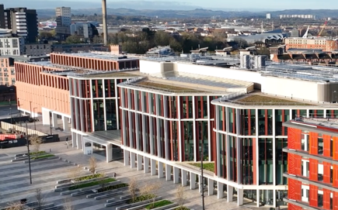
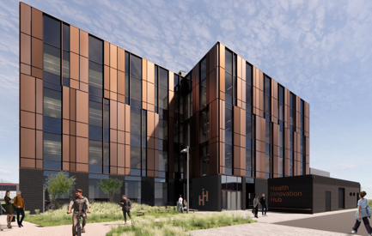

GLASGOW RIVERSIDE INNOVATION DISTRICT
Glasgow Riverside Innovation District (GRID) is an ambitious partnership between the University of Glasgow, Glasgow City Council and Scottish Enterprise to accelerate an inclusive approach to innovation.
GRID’s key anchor institution is the University of Glasgow a recognised leader in life sciences, quantum, artificial intelligence (AI), extended and virtual reality (XR/VR), semiconductors, creative/cultural economies and energy.

Slide 78

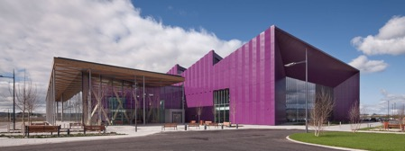
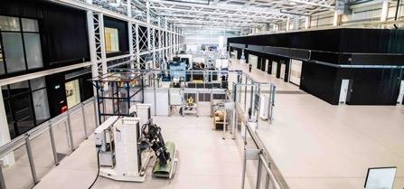
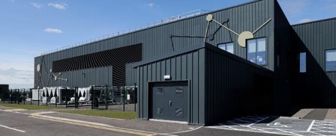




ADVANCED MANUFACTURING INNOVATION DISTRICT SCOTLAND
AMIDS
The Advanced Manufacturing Innovation District Scotland (AMIDS) is an internationally recognised centre for innovation, research and manufacturing. AMIDS is led by Renfrewshire Council in partnership with Scottish Enterprise and Scottish Government (with high levels of IUK funding providing underpinning through HVM Catapult).
NMIS
The new £65M National Manufacturing Institute Scotland (NMIS) is located at AMIDS, a place where industry, academia and the public sector work together on ground-breaking manufacturing research to transform productivity, make companies more competitive and boost the skills of the country’s current and future workforces.
Long-standing industrial co-investment partners include Rolls-Royce, Boeing, Timet, Aubert-Duvall, Siemens and other OEMS and supply chain partners.
MMIC
Pharmaceutical industry partners have chosen AMIDS as the location of the new industry-led £56M Medicines Manufacturing Innovation Centre.
The Medicines Manufacturing Innovation Centre was established by a collaboration between CPI, the University of Strathclyde, UK Research and Innovation, Scottish Enterprise and founding industry partners, AstraZeneca and GSK.

Slide 79
CITY MASTERPLAN

Slide 80
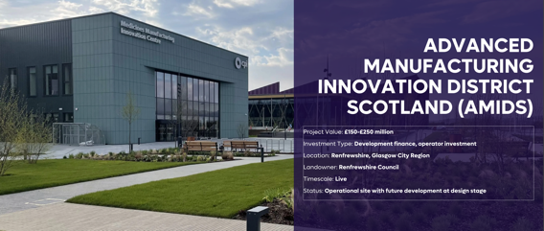
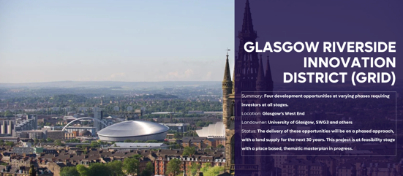
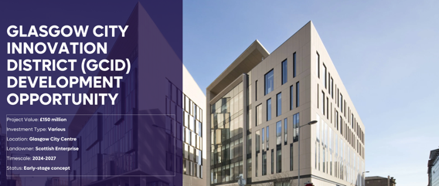
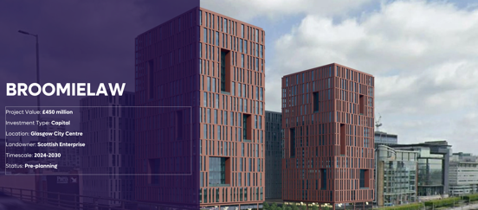
GROWTH INFRASTRUCTURE

Slide 81

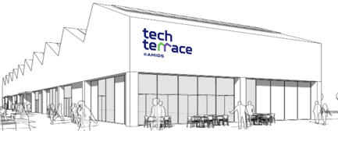


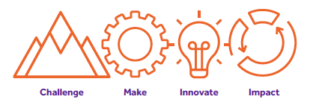
VENTURE BUILDING

Slide 82
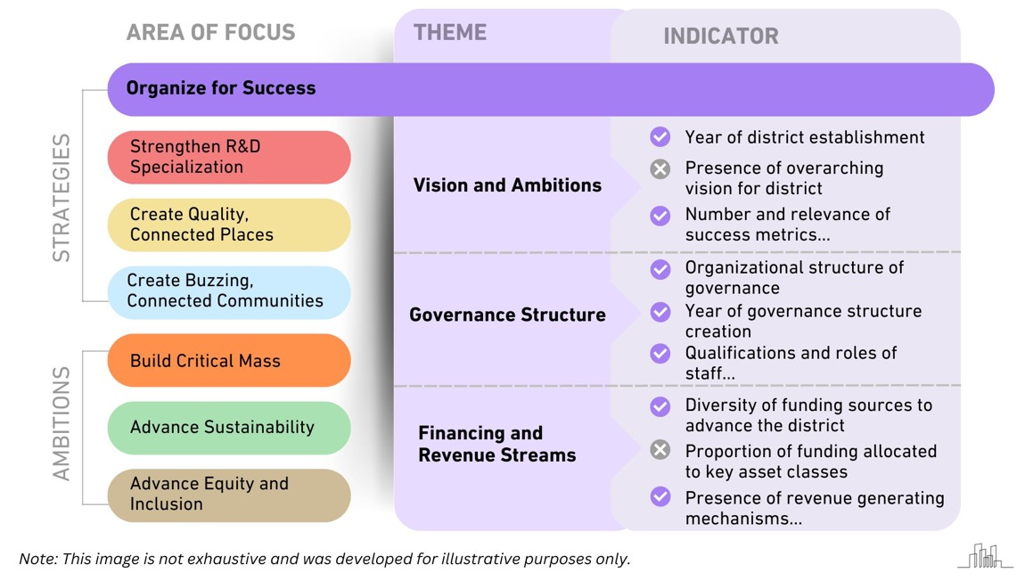
INNOVATION DISTRICT PLAYBOOK

Slide 83




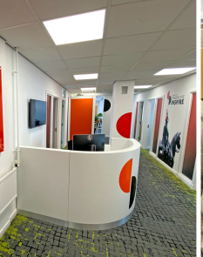
ADVANCING AN
INNOVATION DISTRICT
Anchor Institutions – Universities, Colleges, Technology Institutions enable Collaborative Innovation, Spinouts
Translational Innovation – Innovation Institutes and Centres
Ecosystem Building – Accelerators, Incubators, Corporate and Social Innovation, Community Networks
Investment – Infrastructure, Venture Investment, Property, Philanthropy
Mission Programmes – Economic Development, Governance, Inclusive Innovation, Civic

Slide 84
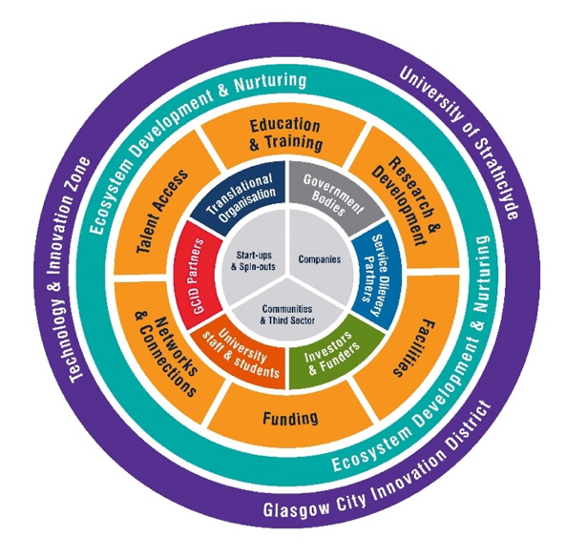
















INNOVATION ECOSYSTEM
4 x Scottish Innovation Centres
Strathclyde
Entrepreneurship
Scotland’s Tech Scaler
4 x UK Funded Catapults
Scotland’s 5G
Centre
UK funded Research and Technology Organisations
UK’s only based Fraunhofer Institute

Slide 85
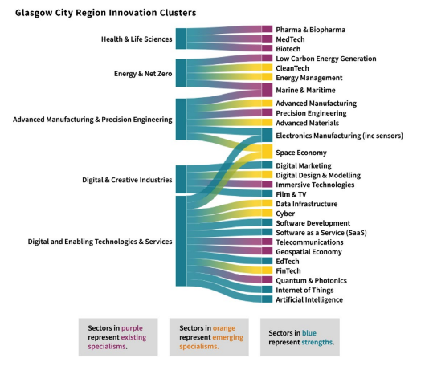
INNOVATION CLUSTERS - Regional Sector Specialisms

Slide 86

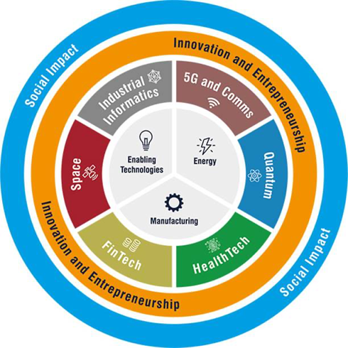
INDUSTRY CLUSTERS
3 existing and initial set of 6 new industry clusters
HealthTech
Spin-in Enmovi now based in Inovo following £2.5 M investment from SE
FinTech
Strategic partnership with FinTech Scotland with space in TIC
5G / Next Generation Comms
Scottish 5G Centre of Excellence hosted at Strathclyde with £5.3M of ScotGov funding
Industrial AI
Two spin-out companies have recently secured investment of £3.9M
Quantum
MSquared’s Quantum Research Facility in Inovo. Strathclyde-led partnership, secured £4.6M for quantum computer development
Space
Collaboration agreement signed with Clydespace. UK Space Agency Accelerator launched Feb 2021

Slide 87





























DISTRICT ECOSYSTEM BUILDING
Innovation Districts
National and Regional Support
Accelerators & Incubators
Ecosystem Development
Innovation Centres
UK Catapults
Technology Institutes

Slide 88


Slide 89
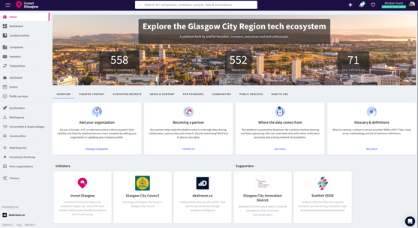



SCALING DISTRICT ECONOMIES

Slide 90

ECOSYSTEM STATISTICS – Glasgow’s Growth

Slide 91

ECOSYSTEM STATISTICS – VC Investment

Slide 92






















GLASGOW’S INVESTOR
NETWORK

Slide 93

ECOSYSTEM STATISTICS – Deeptech Spinouts

Slide 94


GLASGOW CITY REGION INNOVATION ACTION
PLAN
Outcome: Deliver a shared vision that Glasgow City Region will be one of the most innovative places in the UK, where all communities and businesses benefit from the opportunities that the Action Plan brings.
Key Priorities:
Inclusive Economy: Further our inclusive approach to regional growth by ensuring more people and businesses in the city region participate in and benefit from innovation.
Skills: Attract, train and retain our talent across the city region and beyond to address current and future innovation skills needs activity.
Ecosystem: Grow our connected innovation ecosystem such that it supports a globally competitive business community and is tailored to sectoral needs.
Identity: Amplify our distinctive identity and vision through further promotion of our ambition, our strengths and everything that our region has to offer.
Investment: Increase the breadth and level of funding and investment coming into the city region in a targeted and sustainable way.
Infrastructure: Harness our innovation strengths and infrastructure such that we have more places to innovate, to grow, and a culture to enable this.

Slide 95

GLASGOW CITY REGION
INVESTMENT ZONE
The tax incentives and funding that are being made available by the UK and Scottish governments will attract investment, improve skills, provide specialist business support and improve local infrastructure.
Investment Zones are focused around research institutions such as universities. They focus on driving growth in priority sectors including technology, the creative industries, life sciences, advanced manufacturing and the green sector.

Slide 96
GLASGOW CITY
INNOVATION
DISTRICT
SCOTLAND’S FIRST
INNOVATION DISTRICT
GLASGOW CITY INNOVATION DISTRICT

Slide 97


Slide 98

Julia McMurdie
Ayrshire 5GIR Project Lead
Digital Renewal Manager
North Ayrshire Council

Slide 99


Slide 100



Slide 101


Slide 102






Six Themes
Six Workstreams
Digital
Economy

Slide 103







Ayrshire Digital Economy Framework
Transforming Ayrshire into a digitally inclusive region that embraces innovation, fosters economic growth, and enhances the quality of life for all residents while positioning itself as a leading destination for digital investment and collaboration.
Digital Infrastructure
Advancing Ayrshire's Digital Infrastructure
  Develop a robust digital infrastructure to enhance connectivity, attract investment, and position the region as a leading digital hub.
Digital Connectivity
Seamless Digital Connectivity in Ayrshire
  Ensure reliable and high-speed internet access, including 5G technology for businesses, residents, and public services, driving economic growth and fostering digital innovation.
Digital Innovation
Fuelling Digital Innovation and productivity in Ayrshire
  Cultivate a culture of innovation, research, and digital adoption to drive economic growth, productivity, and sustainability.
Digital Skills
Building a Skilled Digital Workforce in Ayrshire
  Equip individuals and businesses with the necessary digital skills and capabilities to thrive in the digital economy.
Digital Inclusion
Fostering Digital Inclusion for All in Ayrshire
  Promote digital inclusion and equity by ensuring equal access to digital technologies, reducing digital poverty, and improving well-being.
MISSIONS
  Three cross-cutting themes: Empowering digital champions, leveraging data-driven decision-making, and embracing sustainability for a thriving and inclusive digital economy in Ayrshire.
Notes:
Now let take a look at our regional work. As I mentioned we have been instrumental in the develop Ayrshire Digital Economy Framework as part of the Regional Digital Economy working Group.
The Framework is our vision to make Ayrshire a digitally inclusive region. It's about embracing innovation, fostering economic growth, and enhancing the quality of life for all residents.
Advancing Ayrshire's Digital Infrastructure "Under the Digital Infrastructure pillar, our mission is to develop robust digital infrastructure that enhances connectivity, attracts investment, and positions Ayrshire as a leading digital hub. To achieve this, we aim to:
Improve digital connectivity by expanding broadband and mobile coverage, upgrading network infrastructure, and promoting access to advanced technologies.
Enhance collaboration with the telecoms industry to leverage their expertise and investment, and explore funding opportunities through public-private partnerships.“
Seamless Digital Connectivity in Ayrshire "For the Digital Connectivity pillar, we're ensuring reliable, high-speed internet access, including pioneering 5G technology for businesses, residents, and public services. This drives economic growth and fosters digital innovation. Our goals are to:
Bridge the digital divide by providing seamless connectivity across Ayrshire, ensuring equitable access to digital services and opportunities for all.
Enhance economic growth and the quality of life through reliable and high-speed internet access, empowering individuals and businesses to thrive in a digital economy.“
Fuelling Digital Innovation and Productivity in Ayrshire "The Digital Innovation pillar is all about cultivating a culture of innovation, research, and digital adoption to drive economic growth, productivity, and sustainability. We will:
Promote collaboration between industries, academia, and the public sector to accelerate digital innovation and knowledge exchange.
Encourage the adoption of advanced technologies and digital best practices across sectors to enhance competitiveness and stimulate innovation-led growth.“
Building a Skilled Digital Workforce in Ayrshire "In our Digital Skills pillar, we focus on equipping individuals and businesses with the digital skills needed for the digital economy. Our strategy includes:
Fostering a culture of lifelong learning and skill development to meet evolving job market demands and support inclusive economic growth.
Providing accessible digital skills training programs and mentorship, ensuring that individuals and businesses in Ayrshire are empowered to succeed in the digital age.“
Fostering Digital Inclusion for All in Ayrshire "Digital Inclusion is paramount. We aim to promote digital equity by ensuring access to technology for all, reducing digital poverty, and improving well-being. Our objectives are to:
Reduce digital exclusion by addressing access, affordability, and literacy barriers, particularly in underserved communities.
Enhance digital well-being and social connectivity by fostering digital confidence, safe practices, and supporting digital champions and community-led digital inclusion initiatives.“
Three Cross-Cutting Themes "Finally, we have three cross-cutting themes that weave through our pillars: empowering digital champions, leveraging data for decision-making, and embracing sustainability. These are the guiding principles that will drive our collective efforts towards a thriving and inclusive digital economy in Ayrshire."

Slide 104


Slide 105


Slide 106


Slide 107








Ayrshire 5G Innovation Region Projects

Slide 108

























Impact of the Ayrshire 5G Innovation Region
INPUTS
OUTPUTS
OUTCOMES
OBJECTIVES
STAKEHOLDERS
PROJECTS
USE CASES
MEDIUM TERM OUTCOMES
LONG TERM AIMS
Project 1: Advanced Manufacturing
  5G Ecosystem Development
Technological Excellence
Improving partnership working across key stakeholders
Project 2: Aerospace Innovation with 5G
Increasing collaboration between the public sector, businesses and mobile industry suppliers
Innovation Ecosystem
Project 3:
SME 5G/IoT Adoption
Improving knowledge and nurturing innovation in businesses
Individual Project Uses Cases
Enhance businesses’ understand of advanced wireless technologies
Economic
Growth
Project 4:
5G for Tourism and Events
Developing economic development leads knowledge of digital connectivity solutions to drive innovation with business
Skills & Talent Development
Project 5:
Immersive Learning
Upskilling workers and students in advanced wireless and digital connectivity technologies
Training workers in advanced digital tools and solutions
Crosscutting workstream 6:
5G Ecosystem Development
Investment Influence
Ensuring the future competitiveness of the Ayrshire economy

Slide 109






Project 1a and 3 – SME 5G/IoT Adoption
ABOUT THE PROJECT
Led by East Ayrshire Council and the Scotland 5G Centre, this project aims to deliver grant funding to multiple SMEs across the region, which will demonstrate the use cases and applications of 5G and other advanced wireless technologies. Focussing on the Food & Drink Production, Manufacturing and Logistics sectors these grant funded projects aim to increase awareness of digital solutions and drive economic growth, influence investment and create jobs across Ayrshire.
PARTNERS
PROJECT AIMS
5G Ecosystem Development
Improving knowledge and nurturing innovation in businesses
Upskilling workers and students in advanced wireless and digital connectivity technologies
Improving partnership working across key stakeholders
Enhance businesses’ understand of advanced wireless technologies
Ensuring the future competitiveness of the Ayrshire economy
Increasing collaboration between the public sector, businesses and mobile industry suppliers
Developing economic development leads knowledge of digital connectivity solutions to drive innovation with business

Slide 110
Arthur Smith
Programme Director
Scotland 5G Centre
#Ayrshire5GIR
Arthur Smith | LinkedIn

Slide 111
The Scotland 5G Centre
“The Ayrshire 5GIR programme is a bold initiative, that is set to transform the regions and place it at the forefront of digital manufacturing. The Scotland 5G Centre is proud to be part of this important programme”
Notes:
​

Slide 112


Who we are
The Scotland 5G Centre provides expert advice, support and test facilities to enable the realisation of the benefits brought by adopting advanced wireless communication solutions.
We work with Scotland’s Local Authorities, Businesses and Public Sector, to support and enable digital transformation.
We have extensive expertise in network deployment (mobile and fixed) and access to 5G testbeds in Scotland to support you on your digital journey

Slide 113



Our Role in the Ayrshire 5GIR – Building a platform
We are committed to supporting the region’s aspirations for a thriving digital future
This programme is the start of an ambitious journey of economic development for the Region
Adopted a flexible approach to providing support to the programme
Building the Ecosystem
We are helping ensuring that there is a sustainable digital innovation ecosystem in place to support the region’s ambitions
We are involved in multiple aspects of the programme
We are working with all the various regional stakeholders also involved in the project
Notes:
Slide 3. The Ayrshire 5GIR vision: is to become the “UK’s premier manufacturing-focused 5G hub”, driven by five transformative principles: 1) technological excellence, 2) a thriving innovation ecosystem, 3) sustainable economic growth, 4) skills and talent development, and 5) influential investment strategies.
3 strategic locations: the Digital Processing Manufacturing Centre (DPMC) in Irvine, the Aerospace Innovation Hub (AIH) in Prestwick, and the Ayrshire Innovation Park (AIP) in Moorfield, Kilmarnock
Sit on Technical Advisory Board (TAG) as 5G experts, and 5GIR Project Board as key leadership role
The Technical Advisory Group (TAG) will be instrumental in shaping the 5GIR and regional digital economy master plan by providing expert advice and strategic direction on integrating advanced technologies and innovative practices. Their role ensures that the 5GIR and master plan are visionary, technically feasible, and grounded in the latest technological advancements. By evaluating and recommending cutting-edge solutions, the TAG helps to:
Ensure Technological Relevance: They keep the master plan aligned with the latest digital trends and technologies, ensuring that the economy leverages the most effective tools and practices.
Mitigate Risks: By reviewing and assessing technical proposals and projects, the TAG helps to identify potential risks and technical challenges early in the planning process, allowing for pre-emptive solutions or adjustments that enhance the plan’s success.
Boost Innovation: TAG members often bring diverse perspectives and expertise, fostering an innovation environment. Their insights can lead to innovative approaches that drive economic growth and competitiveness.
Enhance Implementation: With their technical expertise, the TAG can guide the practical aspects of implementing digital strategies, ensuring that projects under the digital economy master plan are executed efficiently and successfully.
Stakeholder Confidence: Their involvement reassures stakeholders that the digital economy master plan is designed on a solid technical foundation, increasing confidence among investors, businesses, and the public.

Slide 114




Our role in the Ayrshire 5GIR – Supporting SMEs
SME 5G and IoT Adoption (with East and North Ayrshire Councils and NMIS)
Use of our
in-depth understanding and knowledge of the application of 5G to business needs
Supporting the Council’s digital business advisors to on sell the benefits of 5G to local companies
Delivery of digital innovation challenge programme for local SMEs
Appraisal and selection of SME’s proposed digital innovation project fund applications
Overall management of these Industry focussed projects
Notes:
Slide 3. The Ayrshire 5GIR vision: is to become the “UK’s premier manufacturing-focused 5G hub”, driven by five transformative principles: 1) technological excellence, 2) a thriving innovation ecosystem, 3) sustainable economic growth, 4) skills and talent development, and 5) influential investment strategies.
3 strategic locations: the Digital Processing Manufacturing Centre (DPMC) in Irvine, the Aerospace Innovation Hub (AIH) in Prestwick, and the Ayrshire Innovation Park (AIP) in Moorfield, Kilmarnock
Sit on Technical Advisory Board (TAG) as 5G experts, and 5GIR Project Board as key leadership role
The Technical Advisory Group (TAG) will be instrumental in shaping the 5GIR and regional digital economy master plan by providing expert advice and strategic direction on integrating advanced technologies and innovative practices. Their role ensures that the 5GIR and master plan are visionary, technically feasible, and grounded in the latest technological advancements. By evaluating and recommending cutting-edge solutions, the TAG helps to:
Ensure Technological Relevance: They keep the master plan aligned with the latest digital trends and technologies, ensuring that the economy leverages the most effective tools and practices.
Mitigate Risks: By reviewing and assessing technical proposals and projects, the TAG helps to identify potential risks and technical challenges early in the planning process, allowing for pre-emptive solutions or adjustments that enhance the plan’s success.
Boost Innovation: TAG members often bring diverse perspectives and expertise, fostering an innovation environment. Their insights can lead to innovative approaches that drive economic growth and competitiveness.
Enhance Implementation: With their technical expertise, the TAG can guide the practical aspects of implementing digital strategies, ensuring that projects under the digital economy master plan are executed efficiently and successfully.
Stakeholder Confidence: Their involvement reassures stakeholders that the digital economy master plan is designed on a solid technical foundation, increasing confidence among investors, businesses, and the public.

Slide 115


Our Role in the Ayrshire 5GIR – Supporting Innovation
Aerospace Innovation (with UWS)
1
Support in the procurement and deployment of a 5G Network for UWS.
2
Using expertise in network specifications, procurement and deployment, IoT integration, network use case design and testing.
3
Ensuring network designs are fit for purpose to meet project requirements.
4
Identifying and addressing potential challenges, gaps and problem solve.
5
Holding technical suppliers and Mobile Network Operators (MNOs) accountable for their commitments.
6
Upskilling UWS staff on using the networks and engaging with industry.
Notes:
Slide 3. The Ayrshire 5GIR vision: is to become the “UK’s premier manufacturing-focused 5G hub”, driven by five transformative principles: 1) technological excellence, 2) a thriving innovation ecosystem, 3) sustainable economic growth, 4) skills and talent development, and 5) influential investment strategies.
3 strategic locations: the Digital Processing Manufacturing Centre (DPMC) in Irvine, the Aerospace Innovation Hub (AIH) in Prestwick, and the Ayrshire Innovation Park (AIP) in Moorfield, Kilmarnock
Sit on Technical Advisory Board (TAG) as 5G experts, and 5GIR Project Board as key leadership role
The Technical Advisory Group (TAG) will be instrumental in shaping the 5GIR and regional digital economy master plan by providing expert advice and strategic direction on integrating advanced technologies and innovative practices. Their role ensures that the 5GIR and master plan are visionary, technically feasible, and grounded in the latest technological advancements. By evaluating and recommending cutting-edge solutions, the TAG helps to:
Ensure Technological Relevance: They keep the master plan aligned with the latest digital trends and technologies, ensuring that the economy leverages the most effective tools and practices.
Mitigate Risks: By reviewing and assessing technical proposals and projects, the TAG helps to identify potential risks and technical challenges early in the planning process, allowing for pre-emptive solutions or adjustments that enhance the plan’s success.
Boost Innovation: TAG members often bring diverse perspectives and expertise, fostering an innovation environment. Their insights can lead to innovative approaches that drive economic growth and competitiveness.
Enhance Implementation: With their technical expertise, the TAG can guide the practical aspects of implementing digital strategies, ensuring that projects under the digital economy master plan are executed efficiently and successfully.
Stakeholder Confidence: Their involvement reassures stakeholders that the digital economy master plan is designed on a solid technical foundation, increasing confidence among investors, businesses, and the public.

Slide 116




Our Role in the Ayrshire 5GIR – Supporting Skills and Learning
Immersive Learning (with Ayrshire College)
Provision/loan of a carrier class 5G network to underpin immersive learning project
Setting up the network solution in situ for the College
Sharing our expertise in deployment, network use case design, and testing
Supporting College staff use the network
Notes:
Slide 3. The Ayrshire 5GIR vision: is to become the “UK’s premier manufacturing-focused 5G hub”, driven by five transformative principles: 1) technological excellence, 2) a thriving innovation ecosystem, 3) sustainable economic growth, 4) skills and talent development, and 5) influential investment strategies.
3 strategic locations: the Digital Processing Manufacturing Centre (DPMC) in Irvine, the Aerospace Innovation Hub (AIH) in Prestwick, and the Ayrshire Innovation Park (AIP) in Moorfield, Kilmarnock
Sit on Technical Advisory Board (TAG) as 5G experts, and 5GIR Project Board as key leadership role
The Technical Advisory Group (TAG) will be instrumental in shaping the 5GIR and regional digital economy master plan by providing expert advice and strategic direction on integrating advanced technologies and innovative practices. Their role ensures that the 5GIR and master plan are visionary, technically feasible, and grounded in the latest technological advancements. By evaluating and recommending cutting-edge solutions, the TAG helps to:
Ensure Technological Relevance: They keep the master plan aligned with the latest digital trends and technologies, ensuring that the economy leverages the most effective tools and practices.
Mitigate Risks: By reviewing and assessing technical proposals and projects, the TAG helps to identify potential risks and technical challenges early in the planning process, allowing for pre-emptive solutions or adjustments that enhance the plan’s success.
Boost Innovation: TAG members often bring diverse perspectives and expertise, fostering an innovation environment. Their insights can lead to innovative approaches that drive economic growth and competitiveness.
Enhance Implementation: With their technical expertise, the TAG can guide the practical aspects of implementing digital strategies, ensuring that projects under the digital economy master plan are executed efficiently and successfully.
Stakeholder Confidence: Their involvement reassures stakeholders that the digital economy master plan is designed on a solid technical foundation, increasing confidence among investors, businesses, and the public.

Slide 117
David Hernandez
Project Manager
University of Strathclyde – National Manufacturing Institute Scotland
David.hernandez@strath.ac.uk
https://www.linkedin.com/in/david-hernandez

Slide 118






Project 1 – Advanced Manufacturing
ABOUT THE PROJECT
This project, led by NMIS and hosted at Scotland’s Digital Process Manufacturing Centre aims to showcase the transformative effect of wireless connectivity and digital technologies in advanced manufacturing including food and drink and life sciences. Through engaging with businesses across the region on investing in the many advanced manufacturing use cases of 5G, including around quality control, training and data analytics. This will help to stimulate investment and economic growth across the region.
PARTNERS
PROJECT AIMS
5G Ecosystem Development
Improving knowledge and nurturing innovation in businesses
Upskilling workers and students in advanced wireless and digital connectivity technologies
Improving partnership working across key stakeholders
Enhance businesses’ understand of advanced wireless technologies
Training workers in advanced digital tools and solutions
Increasing collaboration between the public sector, businesses and mobile industry suppliers
Developing economic development leads knowledge of digital connectivity solutions to drive innovation with business
Ensuring the future competitiveness of the Ayrshire economy

Slide 119



Project 1A – SME 5G/IoT Adoption
ABOUT THE PROJECT
Led by North Ayrshire Council and the Scotland 5G Centre, this project aims to deliver grant funding to multiple SMEs across the region, which will produce the use cases and applications of 5G and other advanced wireless technologies that will be showcased via the DPMC. Focussing on the Manufacturing sectors these grant funded projects aim to increase awareness of digital solutions and drive economic growth, influence investment and create jobs across Ayrshire.
PARTNERS
PROJECT AIMS
5G Ecosystem Development
Improving knowledge and nurturing innovation in businesses
Upskilling workers and students in advanced wireless and digital connectivity technologies
Improving partnership working across key stakeholders
Enhance businesses’ understand of advanced wireless technologies by developing Roadmapping in Digital Transformation
Ensuring the future competitiveness of the Ayrshire economy
Increasing collaboration between the public sector, businesses and mobile industry suppliers
Developing economic development leads knowledge of digital connectivity solutions to drive innovation with business

Slide 120





Digital Process Manufacturing Centre
30 September 2024

Slide 121

National Manufacturing Institute Scotland
A group of industry-led manufacturing R&D facilities where research, industry and the public sector work together to transform skills, productivity and innovation to attract investment and make Scotland a global leader in advanced manufacturing.
The Digital Process Manufacturing Centre (DPMC)
is a partnership between National Manufacturing Institute
Scotland, North Ayrshire Council, and Centre for Process
Innovation located at i3 in North Ayrshire.
The focus of the DPMC will be to demonstrate,
develop and deliver digital technology to
support manufacturing challenges.

Slide 122


Digital Process Manufacturing Centre
5GIR delivery partner responsible for showcasing transformative effect of wireless connectivity and digital technologies in advanced manufacturing including food and drink and life sciences. Main activities include:
  Hosting Mobile Private Network
  Use case deployment including Metaverse in Manufacturing and Gamified Learning
  Industry engagement including consultancy and solution delivery
Scoping and delivering tailored projects including 5G integration with technologies including:
  IoT networks for real time condition monitoring
  Asset tracking over large manufacturing areas and in service tracking

Slide 123
Outcomes and Impact
DPMC will support the local adoption of advanced wireless technologies in key sectors such as food & drink, pharma, manufacturing, and logistics.
Impact:
  Productivity gains by improving process control monitoring
  cost savings by automating resource intensive administrative processes
  Sustainability by reducing material waste and excess energy
  Ayrshire's economic growth and digital integration
Benchmark success through:
  Industrial investment in advanced manufacturing
  Improvements in wireless technology adoption
  Knowledge exchange within Ayrshire

Slide 124
Future Vision and Collaboration
Continued work with DPMC becoming key delivery partner for the Ayrshire Innovation Ecosystem by driving innovation, supporting the development of 5G use cases, and continuing to foster collaboration across sectors.
Develop new strategic sectoral projects, focusing on enhancing digital adoption in advanced manufacturing
Ongoing delivering of digital upskilling, knowledge exchange, and sustainability plans that ensure DPMC and Ayrshire’s Digital Economic Strategy success beyond the grant funding period.

Slide 125







Benefits of 5G
Real-time data-driven decision-making
Extending the lifespan of equipment & appliances
Reduce waste, improve energy efficiency, and support sustainability goals

Slide 126
Summary
5G has benefits across society from manufacturing to learning, and housing.
The Digital Process Manufacturing Centre (DPMC) is a partnership between National Manufacturing Institute Scotland, North Ayrshire Council, and Centre for Process Innovation located at i3 in North Ayrshire.
The Centre is the technology delivery partner responsible for showcasing the transformative effect of wireless connectivity and digital technologies in advanced manufacturing.
By providing improvements in quality control, training, and data analytics, DPMC will deliver industrial benefits including productivity gains, cost savings, and improved sustainability.
DPMC is part of the wider innovation ecosystem and key component to all advanced manufacturing digital transformation in support of the Ayrshire’s Digital Economic Strategy.

Slide 127






Ayrshire 5GIR (youtube.com)
Notes:
‘Ayrshire Digital Economy: 5G Innovation Region’ is Ayrshire’s flagship project driving connectivity innovation and adoption across the region.
Funded by Department of Science, Technology and Innovation, this new project is being delivered by the three Ayrshire councils: North, South and East, and is supported by partners across education, technology, process manufacturing, aerospace, mobile and tourism industries.
Selected as part of a UK-wide funding competition as one of 10 innovation regions, and one of only two in Scotland, this £3.7m project aims to put Ayrshire on the map as a true digital innovator.
The 5GIR project builds on the successful innovation hubs approach in Ayrshire and offers the opportunity to test 5G and advanced wireless technologies and help key stakeholders within the region understand how they can be deployed in their organisation.
Across five workstreams, the project is set to create a 5G innovation ecosystem that will benefit local businesses, help upskill current and future workforce and ensure regional competitiveness.
We see collaboration as the key component to innovation in Ayrshire, so get involved today!
@ayrshire.com (TBC)

Slide 128

Julia McMurdie
Ayrshire 5GIR Project Lead
Digital Renewal Manager
North Ayrshire Council
#Ayrshire5GIR
juliamcmurdie@north-ayrshire.gov.uk
https://www.linkedin.com/in/jmcmurdie/

Slide 129
Borderlands 5G Innovation Region
Glasgow Connectivity Conference October 2024

Slide 130



Introductions
Tony Sceales & Guy Middleton

Slide 131

Session overview
2
THINGS WE’VE LEARNED
WHAT? WHERE? WHAT FOR?
1

Slide 132
What we have done…
WHAT? WHERE? WHAT FOR?
1

Slide 133


Borderlands 5GIR - Scale
10% UK landmass, 350 km to drive between venues
4 counties, 2 countries
c.1 million population
63 million visitors in 2019
2 World Heritage Sites
Challenging terrain and weather
Borderlands contributes £23bn to the UK
45,000 businesses
Within 2 hours drive of 14m people
5 Venues –
  Destination Tweed
  Kielder Castle and Forest
  The Sill @ Hadrian’s Wall
  Stranraer Marina
  Windermere 5G Ferry
M25

Slide 134

High Level Technical Design & Scope
A technical 5G solution which consists of:
5G Mobile Private Network
  An Open Radio Access Network (ORAN)
  Core Network
  Network Firewalls & Gateways
With various sensors and data inputs spread across the venues
A shared data platform which will be used by all 5 venues
A shared Mobile App
ESIMs + Wi-Fi for public connectivity
Extensible – more coverage, more function, more venues
All networks, not just 5G...

Slide 135


Flexible and Scalable: As technology evolves, network adapts to meet the needs of the community for years to come
Edge-Enabled and Responsive: Processes data close to the source, reducing latency and enhancing real-time application performance
Seamless Connectivity and Reliable: high-quality connections with built-in redundancy, ensuring consistent network performance
www.awtg.co.uk

Slide 136





Use Cases
Got 50, looking for many more
Based on Tourism, but need to be able to find many more adjacent Use Cases, so we've got our eyes open for the opportunities to support more uses of our networks, platforms and applications
Two examples...

Slide 137


How the solution will be used
The solution has many uses
Many use cases are common to most, or all Venues
Some are specific to individual venues
Programme stakeholders from across the Borderlands region have helped to identify and prioritise the use cases that will be delivered and demonstrated by the end of the DSIT 5GIR funding period, 31st March 2025
Priority use cases identified:
  Person Counting
  Car parking management
  Environmental Monitoring
  Ticketing/Payment support
We have an extensive database of use cases that can be developed and supported beyond the initial funding window to deliver further benefits

Slide 138


Marine Research Centre
South of Scotland Enterprise £150k funding will pay for core monitoring kit
5G IR will provide Stranraer 5G/LoRaWAN coverage, buoys and some further devices – video etc, data platform and app
Extensible to the whole Solway coast - £16m funding
Remote Port management at Stranraer extensible to 4 more ports along the Solway Firth

Slide 139


FDRI: Learning from Water monitoring
Flood and Drought Research Institute - £38m funding from DSIT
Measurement gives people agency, supports science on flooding, drought, quality
Tourism needs have strong correspondence to environment, agritech, council services sector requirements
Practical real-world delivery + need for meta layer – data/apps/services connects up many projects thus collecting value
None of the individual sector uses could afford to pay for widespread coverage alone, but by stacking they probably can
Tweedsmuir

Slide 140
Some interesting things we’ve learned…
2
THINGS WE’VE LEARNED

Slide 141
Procurement
How to buy a 5G network…
Who can provide a 5G network (in its broadest sense)
What technical solutions exist
What limitations there are in the service offering
What things cost…

Slide 142
Market Evolution
Few Public Sector MPNs
  Suppliers not all experienced in bidding under public contracts regulations
  More open – drive stackable use cases. Anchor tenancy will remain key
  Wider benefits – drive public mobile improvements
Market change is happening already, but there’s much to do:
  NHOD and MPN emphasis +++ MNO engagement / win:win
  N77 - Ofcom processes more dynamic, SAL for 6GHz, more spectrum etc.
  Multi-tenanted model and utility pricing
  Device market is limited – buying in volume could drive it faster
  Scope to change the market by joining up the 5GIRs, creating a framework or DPS

Slide 143
Not just 5G…
Real World uses of 5G
  Control - Coverage & capacity under SLA, uplink centric
  Performance characteristics
How do different network types fit together?
  5G
  WiFi
  LPWAN
  Public Network
Why are we talking about a MPN, and how does it fit with the public networks?

Slide 144





Use Cases, Benefits & Commercial Sustainability
USE CASES
£
BENEFITS
COMMERCIAL SUSTAINABILITY

Slide 145
Use Cases
<>

Slide 146


Commercial Sustainability
100
DRIVE GAINSHARE
£
Specific
Variable
Price & Scale Use Cases
Fixed
UNDERSTAND
COSTS
COLLECT ENOUGH FOR THE SERVICES
Find Use Cases

Slide 147
What’s next?
Implementation & Delivery
Operation
  drive value, exploit with more use case takeup
  reach commercial sustainability
Further investment
  Drive more value
  Drive a sustainable market

Slide 149
Glasgow Smart and Connected Social Places - Connectivity Event
21st October 2024

Slide 150











































Delivering value to customers through quality and expertise
Regional and Local Government
Central Government
Technology Vendors
Mobile Network Operators
Vertical Applications
Health and care
Industry Bodies
Researchers
Regulators
Innovative Platforms
Asset exchange and management
Service correlation and assurance
Advance Applications
AI / ML recommender systems
AI / ML customer support systems
Design, Deploy and Operate
More than 20 5G MPN delivered
Thousands of 5G sites deployed and optimised
Coverage and performance maps
Immersive applications
Managed enterprise Wi-Fi for hundreds of buildings
Trusted Partners
Trusted by regulators, local and national governments
Cyber Essentials Plus, IS 27001, ISO 9001, ISO 14001 Certified, HAWASA compliant
R&D, Microservices and IP
5G MPN (Flex-5G) with DAS and RIS
SW IP and microservices for right fit implementation
Hybrid Open Core Software licensing
Bespoke applications using own innovations
Open APIs integration to industry products
Multiple frameworks (Network Services 3, GCloud 13, PFH, etc.)
FRANC, FONR, ONE, UK-ROK R&D

Slide 151
SCONDA (Small Cells OpenRAN Network in Dense Area)
The SCONDA project will build, integrate, optimise and deliver an Open RAN network in Glasgow City Centre, integrated to the existing Three UK Core Network, operating alongside their traditional RAN
Delivery Objectives
The project will aim to deploy a cluster of small cells in hotspot locations in Glasgow City Centre creating a densification layer
The system is capable of serving the needs of Three UK customers in a dense urban environment
Open RAN (Radio Access network) small cells can be deployed in effective manner utilising existing infrastructure where possible
Include a RIC (RAN Intelligent Controller) solution to orchestrate the management of the Open + (multi-vendor) Traditional RAN
Lessons Learned Objectives
The project aims to be a proof point for the Industry on the suitability of Open RAN to enable 5G Connectivity for an MNO in a High Density Demand environment
Increase the knowledge base for a Tier 1 MNO in adopting Open RAN into its eco-system, and Open RAN vendors on the demands of MNO environment
Expected to optimise the deployment of Open RAN into a brownfield MNO environment, focusing on automation and softwarisation of processes and methodologies
Benchmark the Performance, Operational resilience and Scalability of Open RAN in comparison to Traditional RAN

Slide 152










Who are the partners?
AWTG – Programme Lead - bringing its expertise as a system integrator, programme management and softwarisation ensuring that innovations and lessons learned in this project are realised
Three – Technical Owner + Transmission Delivery – Integrating to their Network, and adoption of Open RAN into their eco-system. Delivery of FrontHaul connectivity through Access Transmission partners
Freshwave – Deployment Partner – Site Asset Identification, simple and effective Acquisition, Design and Construction (ADC)
Mavenir – ORAN Provider. Will develop and provide the small cell suitable for Three spectrum, and ORAN based on a new future proof scalable and cost-effective network design
PI Works – RIC Provider. Will integrate its RAN Intelligent Controller and develop suitable rApps for inter-operability and energy saving / load balancing with the Traditional RAN
S5GC – Benefits Realisation and Information Dissemination. Responsible for monitoring and measuring the benefits that are identified at each phase of the project
Accenture – Benchmarking expertise to measure the enhanced customer experience
University of Glasgow – Deployment of an Indoor Network using FlexRAN solution
University of Surrey – ORAN expertise in App development and FlexiDAS solution

Slide 153
What this means?
UK Gov has an ambition of carrying 35% of Network Traffic over open interfaces by 2030 – Deployments like this are a proof-point for this ambition
Small Cells are not necessarily a new concept. But deploying them on Open RAN, in such a high demand area, in a live environment, making it work seamlessly within a multi-vendor eco-system, we believe makes this project unique
Targeting locations using a combination of Network Statistics and Crowd-source data, aim is to uplift user experience in those pockets of high-demand where the customers really need it
Benefit it not just within the City Centre, by offloading the Macro network we are providing additional capacity in small cell location and its surrounding coverage areas
Project ends in March 2025 – but the benefits to Three customers are enduring, the network will remain in life. Scalability of the solution will allow the small cells solution benefits to be extended to other areas
Having that 5G Coverage, and the capacity requirements backed off, is the biggest enabler for the Digital transformation of the region – Unlocking benefits for the residents, tourists and business in e-commerce, smart cities, green strategies… and beyond

Slide 154

Small Cell Densification Layer

Slide 155





Where are we now?
If you are walking around the City and look up, in 10 locations (at the time of writing) you will see these installations, with 32 more appearing in the next couple of months
As the Fibre is delivered, we will be lighting these sites up, completing our optimisation and benchmarking the user experience between now and March 2025
Live Network validation testing is happening NOW, and Three customers will get immediate benefit over the coming weeks

Slide 156

Paul Clegg
Portfolio Lead, 5G Innovation Regions

Slide 157
Networking

